Slide 1
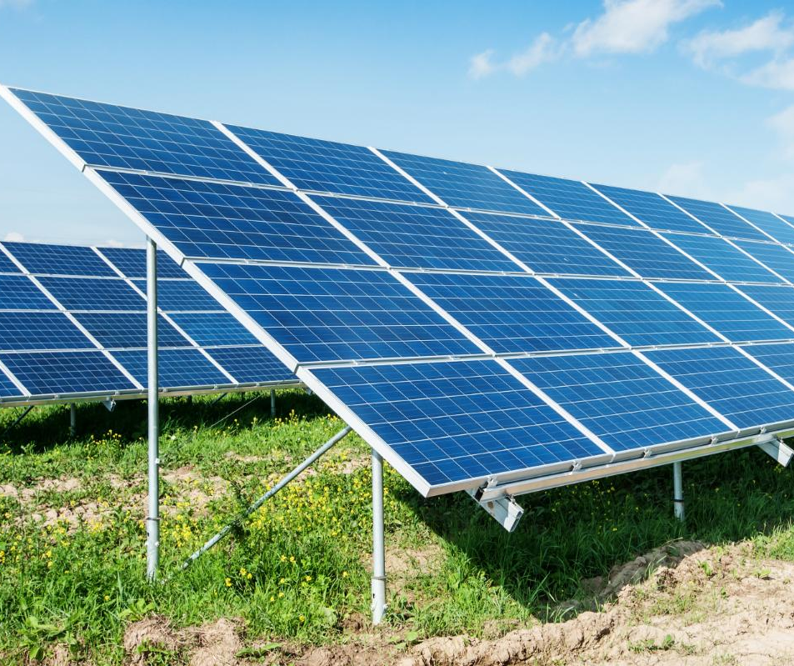
Solar PV Cells Manufacture and Installation

Slide 2
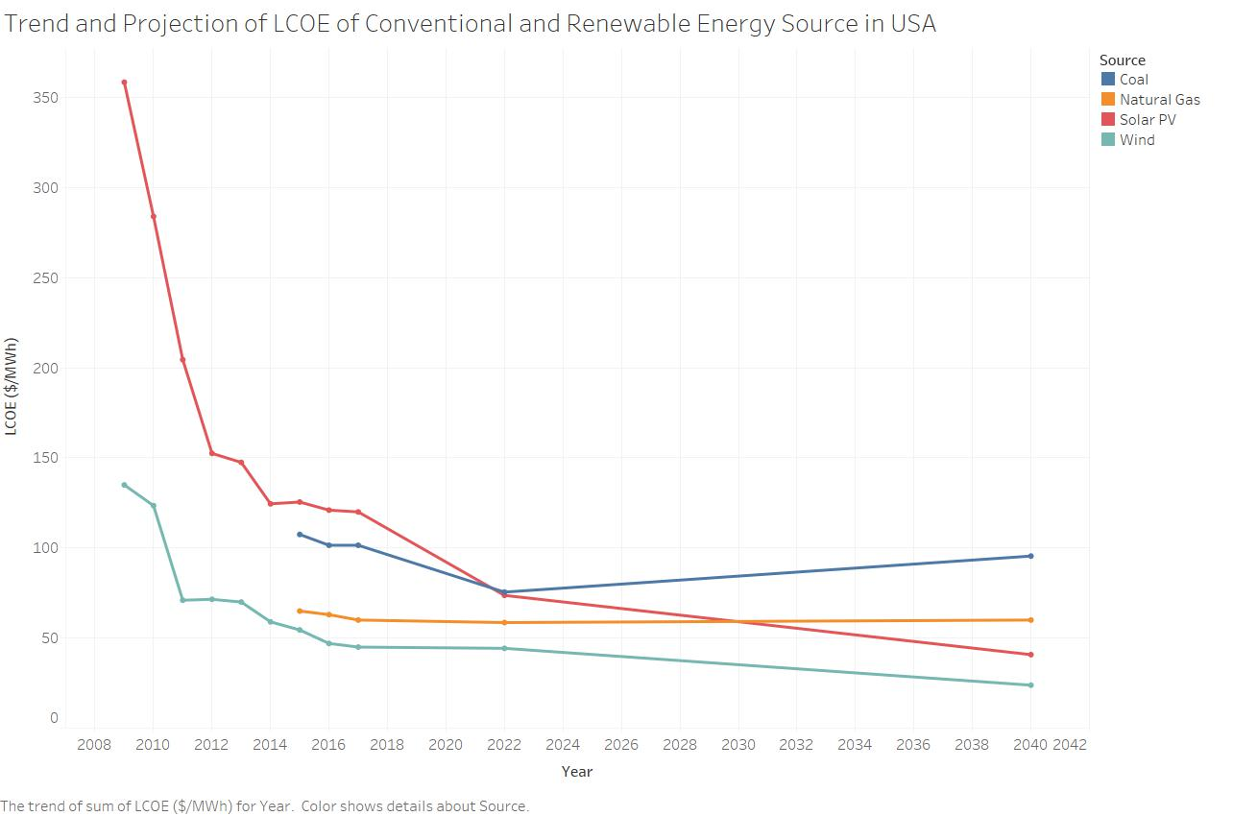
Temporal Graph
Utility-scale solar’s cost declined 85 percent since 2009 to today’s range of $46 to $61 per megawatt-hour.
The levelized cost of electricity from solar is set to drop another 66% by 2040 worldwide
By 2022,solar LCOE is projected to beat coal prices and
Solar PV Seven Year percentage decrease: 66.48%
Data Source: Bloomberg New Energy Finance. “2015 New Energy Outlook – Americas.” June, 2015
Lazard’s levelized Cost of Energy Analysis – Version 10.0
Notes:
To put these cost reductions in perspective, imagine if your cable bill dropped 85 percent with no strings attached: instead of paying $100 per month, you’d be looking at a price tag of $15 per month.

Slide 3
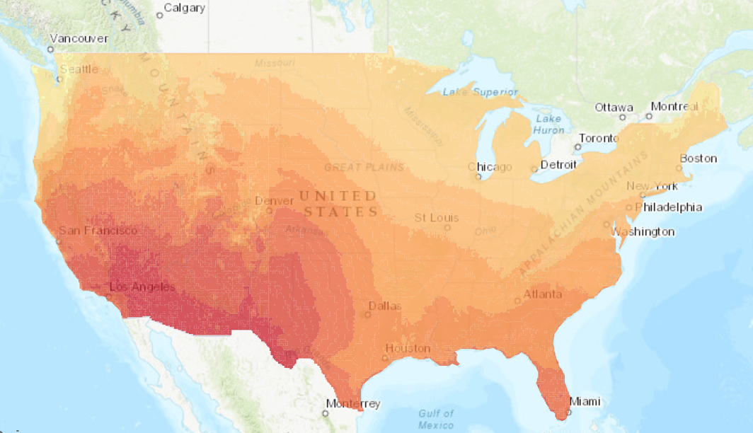
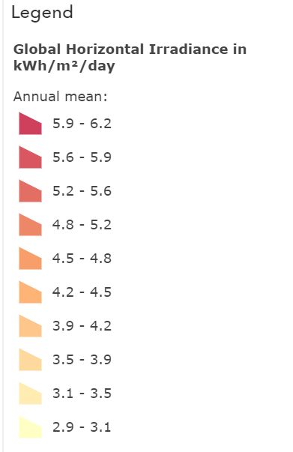
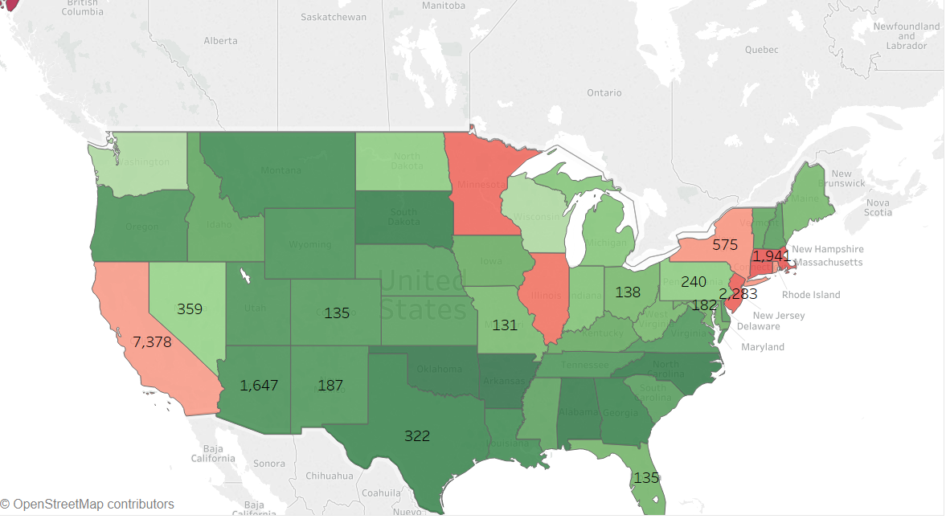
Spatial Graph
What is important in solar irradiance measurements in solar energy projects?
Global Horizontal Irradiance- The ‘BIG’ Performer(71.6% performance variation)
Which places should we consider for investment for each solar energy category?
Arizona, New Mexico & Colorado better choice for investment in terms of energy generation & total cost for ‘UTILITY PV. ’
For Resident Solar Energy Colorado, Texas Florida should be considered as it’s cost effective.
Other factors to be considered for investment based on region?
30% federal ITC to drop by 4% in the year 2020. Take advantage of commence construction rule to avail 30% ITC even after 2020.

Slide 4
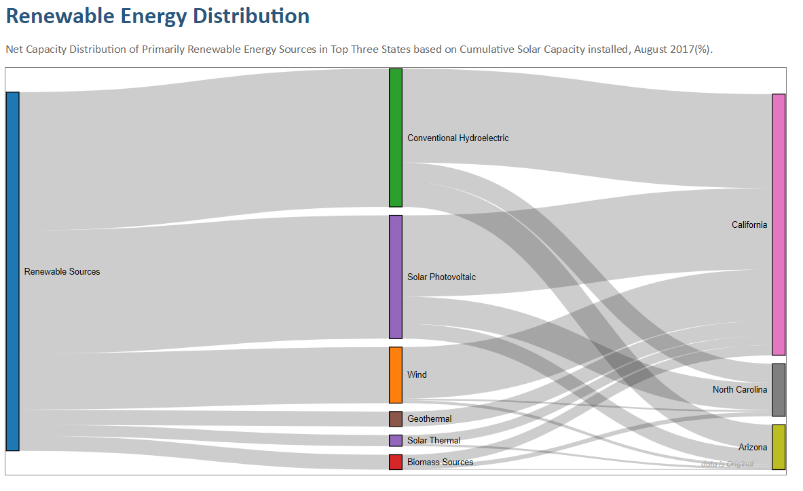
Sankey Diagram
In the top 3 solar energy generating states, a large percentage of energy is currently generated by other renewable energy sources, i.e. solar energy has a huge scope of return on investment in those states.

Slide 5
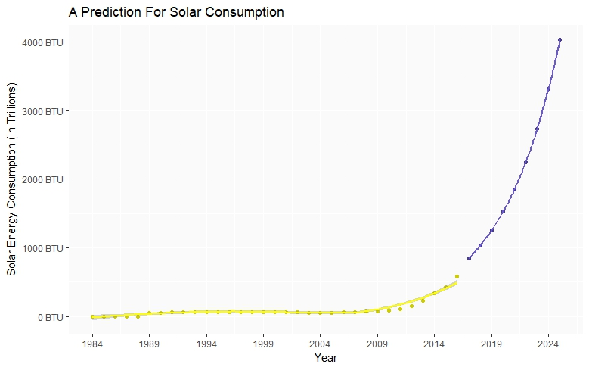
Analytical Graph – Predictive
Consumption growing exponentially
Projected to amplify 5 times the current usage
People are naturalizing solar energy like conventional energy

Slide 6
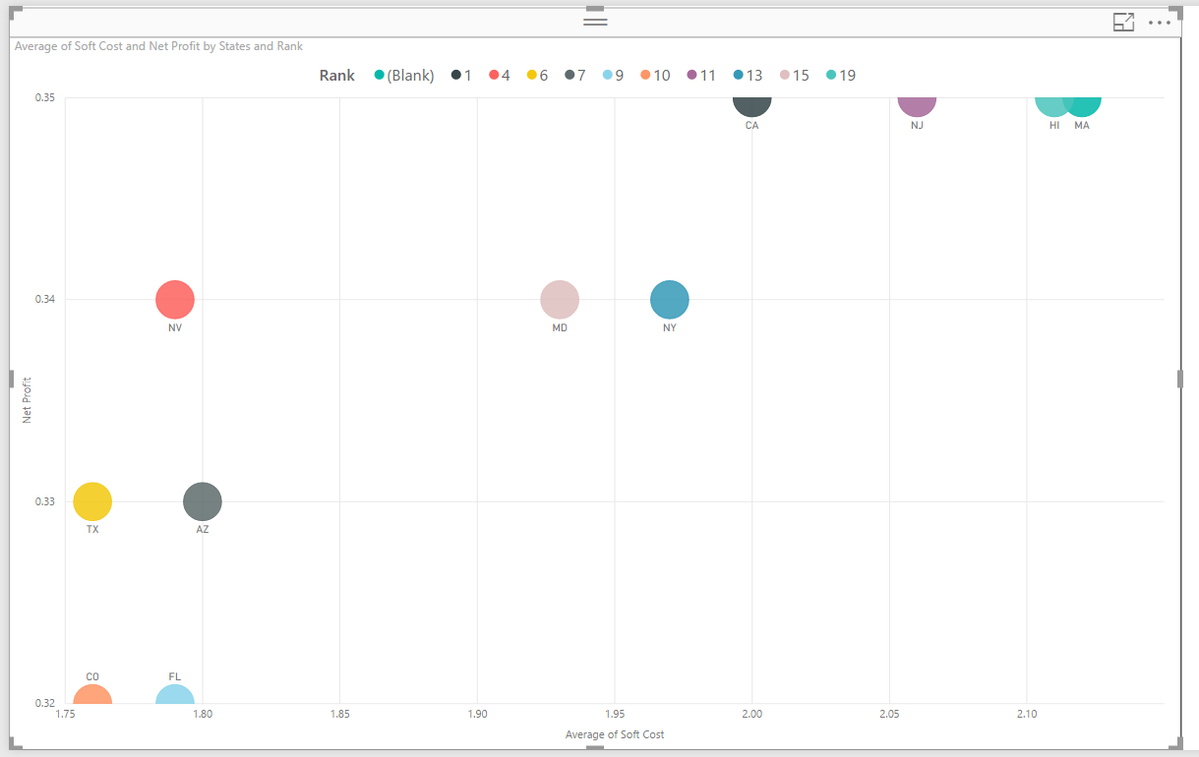
Graph shows the rank of each state and Comparing the Average Soft cost and Net Profit generated for Residential PV category. Based on the soft cost and the net profit we should consider investing in Texas, Arizona and Nevada. Soft cost is the important and deciding factor for investment in solar energy

Slide 7
Summary
Profiting By Getting Solar Panels Installed: Most state governments offer some sort of tax subsidy or grants to encourage more widespread solar panel usage. As a result, the final cost after installation may be reduced from the sticker price. People might also profit from solar energy by having solar panels installed on their own homes or businesses in order to take advantage of net metering to reduce utility bills.
New materials known as perovskites have been incorporated into solar cells and have increased solar cell efficiency in laboratory tests, from a 3.8% efficiency in 2009 to just over 20% by 2014. If technological development in solar continues at this pace, PV electric generation could increase to produce 50% more energy per square foot of solar paneling in just a few short years
The Bottom Line: Solar power is becoming more affordable and more efficient at turning the sun's energy into usable electricity. Despite an oversupply issue attributed mainly to Chinese exports, 2015 has been a banner year for solar stocks so far. As the prices of oil and fossil fuels begin to rise, solar energy will be viewed as a more competitive option, further increasing its demand.
Notes:
Note:New materials known as perovskites have been incorporated into solar cells and have increased solar cell efficiency in laboratory tests, from a 3.8% efficiency in 2009 to just over 20% by 2014. If technological development in solar continues at this pace, PV electric generation could increase to produce 50% more energy per square foot of solar paneling in just a few short years

